Slide 1
Anne Arundel County 311 Service Request Analysis
Thrushwanth Kakuturu
Data Analyst

Slide 2
Objective
The goal of this analysis is to examine service requests submitted through Anne Arundel County’s SeeClickFix/311 platform to identify trends, high-demand areas, and suggest improvements in service delivery.
Dataset Overview:
Total Records: 109,131 service requests.
Time Span: October 2016 – August 2023
Data Size: ~20.8 MB.
Key Fields:
IssueID: Unique ID for each service request.
RequestTypeTitle: Describes the type of service requested (e.g., pothole repair, recycling container).
IssueStatus: Status of the request (open, closed, acknowledged).
DaysUntilClosed: Number of days to close the request.
Latitide/Longitude: Geographic coordinates for request locations.
Department: County department responsible for handling the request.

Slide 3
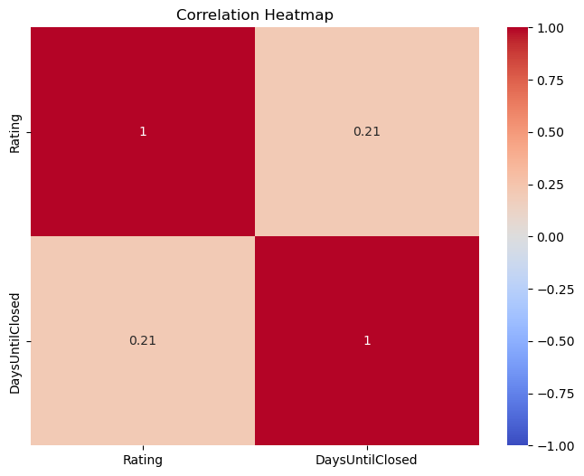
Data Cleaning and Processing
Initial Data:
109,131 records with 25 columns
Data Pruning:
Removed non-essential columns (e.g., FullName, Email) and duplicate columns (IssueType = RequestTypeID).
Dropped columns with excessive missing data: acknowledged_at and reopened_at (both had over 60% missing data).
Dropped Summary and Description as the analysis does not focus on textual data.
Removed IssueStatus as it contained only one category: Archived.
Handling Missing Values:
Filled missing values in DaysUntilClosed using the median to avoid skewness from outliers.
Data Distribution:
Both DaysUntilClosed and Ratings exhibited right-skewed distributions, with significant outliers.
Correlation Analysis:
A correlation heatmap revealed no significant relationship between DaysUntilClosed and Ratings, with a correlation coefficient of only 0.21.

Slide 4
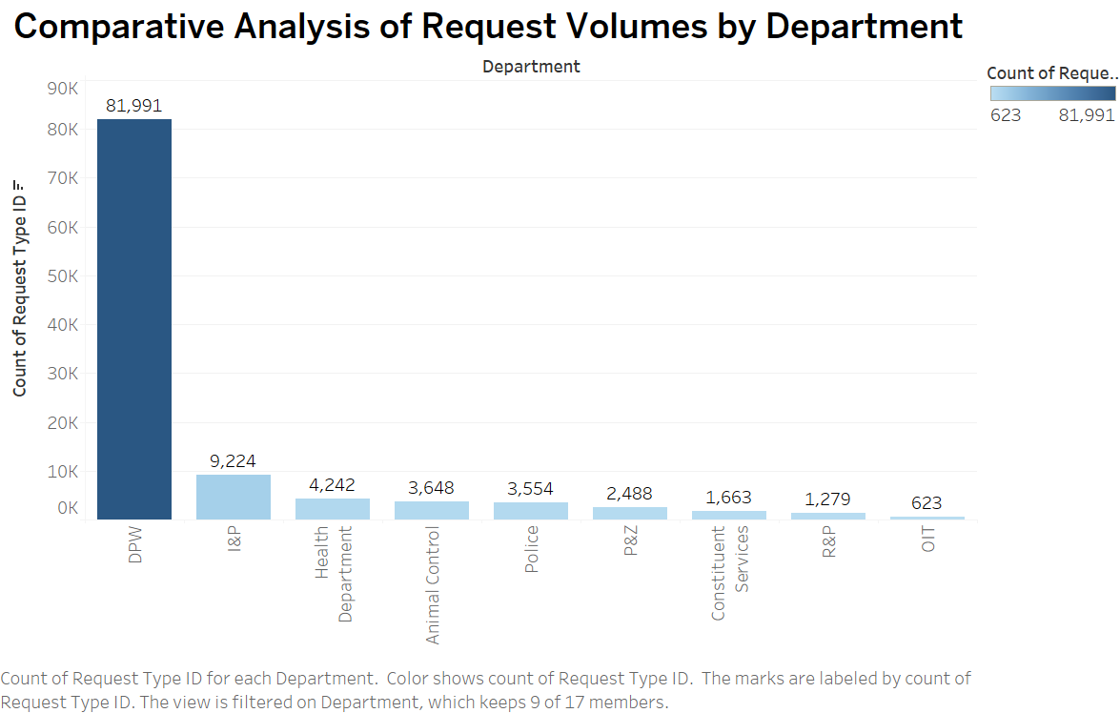
Data Insights and Visualization (Tableau)
Key Insights: Request Distribution Across Departments
Department of Public Works (DPW): This department handles the vast majority of service requests, accounting for around 75% of the total requests.
Other Departments:
Inspections and Permits (I&P) follows with 9,224 requests, making up approximately 8% of the total.
Health Department and Animal Control account for about 4% and 3.5% of the requests, respectively.
Police Department processed 3,554 requests, showing that safety and law enforcement also have notable service demand.
The distribution of requests demonstrates a high dependency on the DPW, highlighting it as a critical area for resource allocation and service improvement.

Slide 5
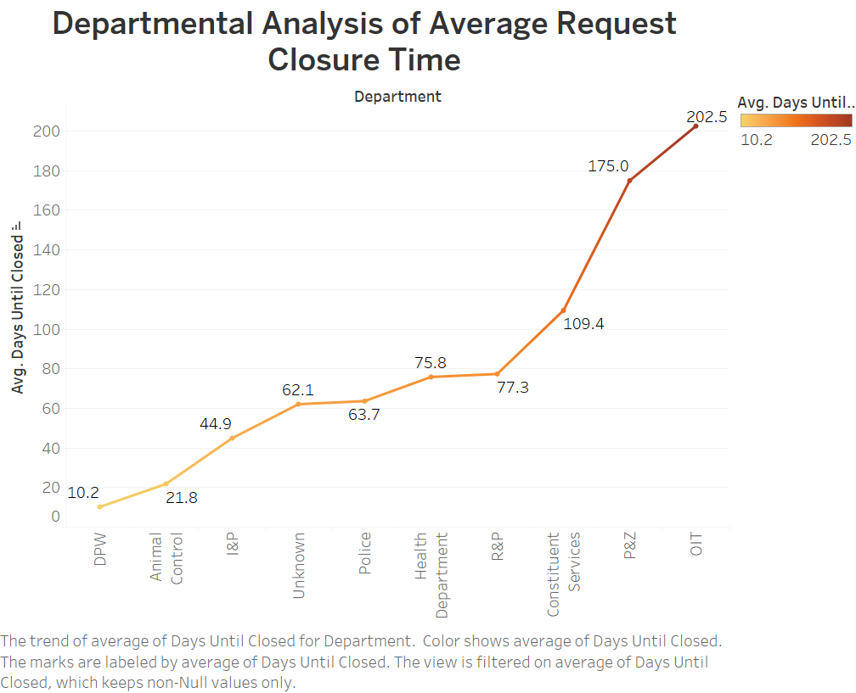
Departmental Analysis of Average Request Closure Time
Insight: The Department of Public Works (DPW) has the shortest average closure time of just over 10 days, reflecting high efficiency.
Other departments like Animal Control and Inspection and Permits also demonstrate relatively short closure times.
However, departments like Planning and Zoning (P&Z) and Office of Information Technology (OIT) show significantly longer closure times, averaging 175 to 202 days, indicating possible challenges in addressing requests promptly.

Slide 6
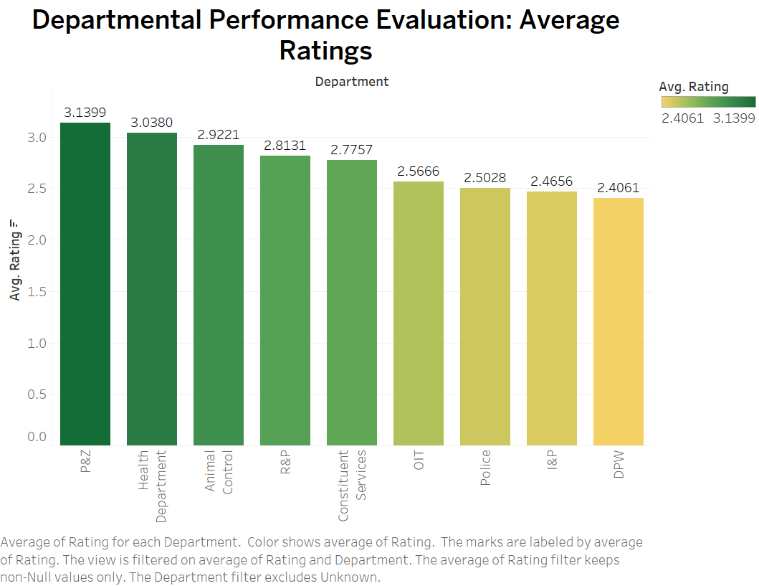
Departmental Performance Evaluation: Average Ratings
Insight: Planning and Zoning (P&Z), Health Department, and Animal Control rank the highest in terms of average ratings from residents, reflecting strong public satisfaction with their services.
DPW, despite its fast closure time, has the lowest rating with an average score of 2.4, suggesting a potential gap between service speed and quality.

Slide 7
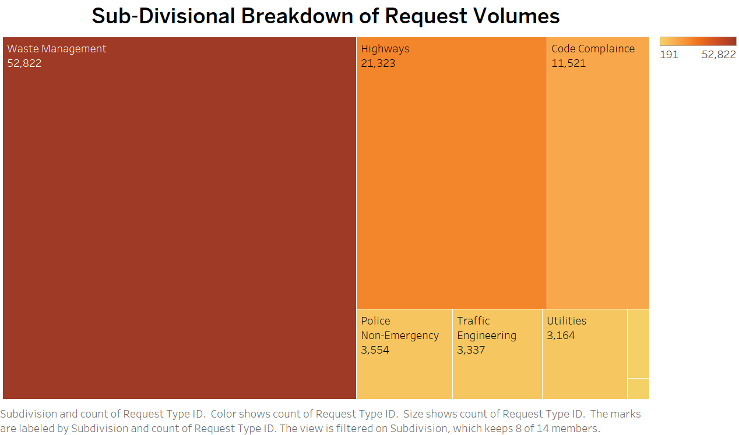
Sub-Divisional Breakdown of Request Volumes
Insight: Waste Management (52,822 requests) and Highways (21,323 requests) receive the highest volumes of service requests, which could be attributed to their critical roles in infrastructure and public services.
Other subdivisions like Code Compliance and Traffic Engineering also contribute significantly to the overall workload, though their request volumes are smaller in comparison.

Slide 8
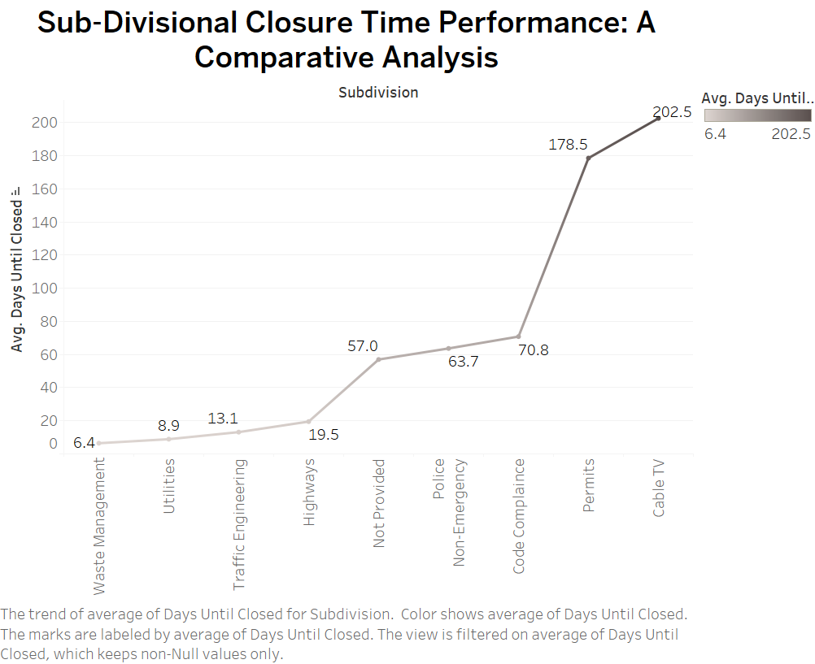
Sub-Divisional Closure Time Performance: A Comparative Analysis
Insight: Waste Management excels in closing requests quickly, with an average closure time of 6.4 days, followed by Utilities and Traffic Engineering.
On the other end, Cable TV and Permits subdivisions take over 200 days to close requests, indicating significant delays in addressing service needs in these areas.

Slide 9
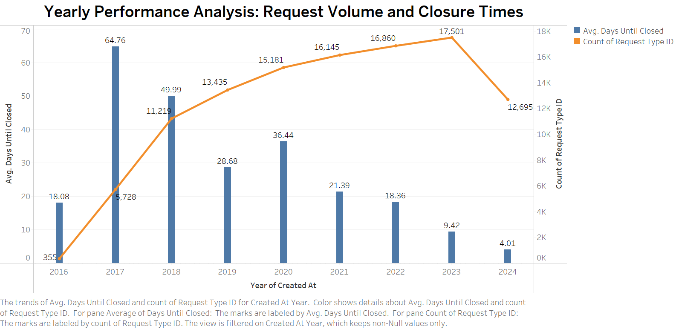
Yearly Performance Analysis: Request Volume and Closure Times
Insight: Over the years, the number of requests has increased, peaking at 17,501 in 2022. However, the average closure time has varied.
2020 saw a spike in closure time, averaging 64.76 days, which may have been influenced by the COVID-19 pandemic and resource constraints. Closure times have since improved slightly but remain longer than in earlier years.

Slide 10
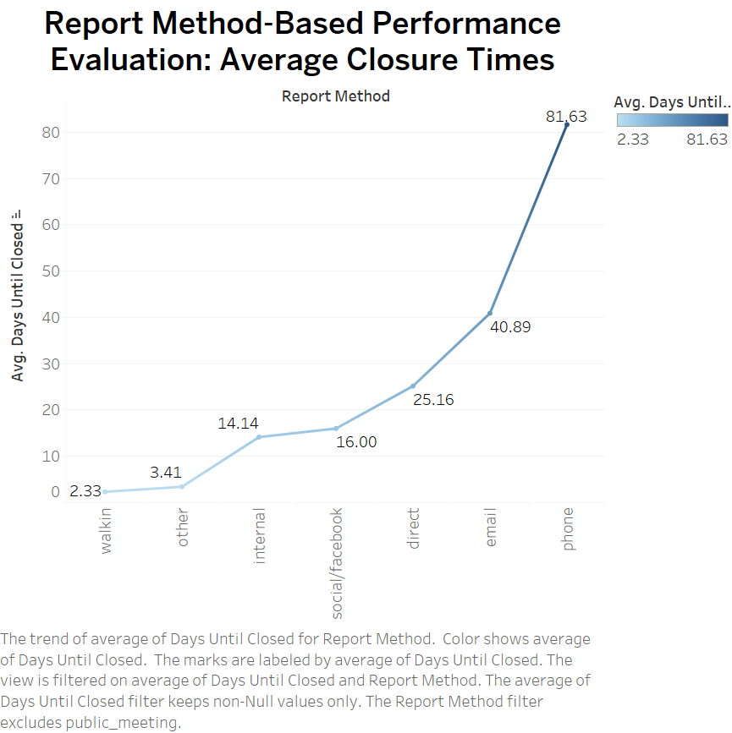
Report Method-Based Performance Evaluation: Average Closure Times
Insight: Requests reported via Walk-in and Other methods are resolved the fastest, with an average of 2 to 3 days until closure.
In contrast, Phone and Email methods show the slowest average closure times, taking over 80 days. This suggests potential inefficiencies in handling service requests through certain communication channels.

Slide 11
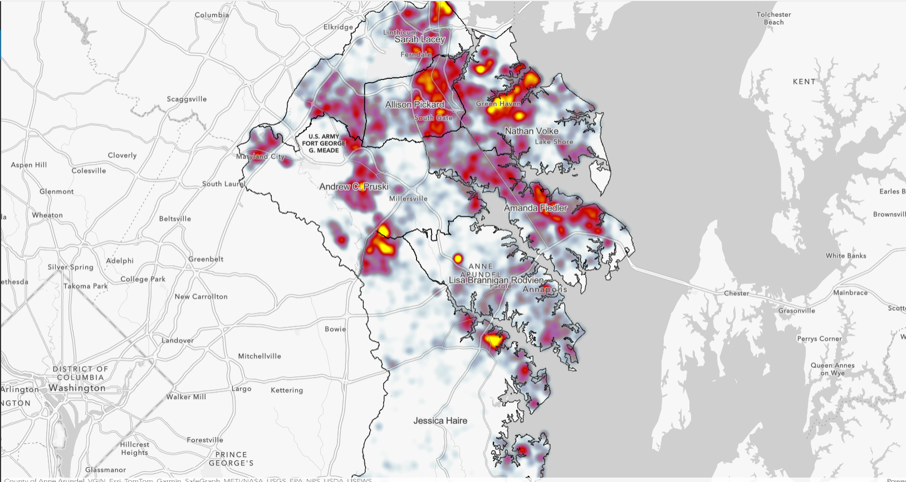
Geospatial Analysis (ArcGIS)
Heatmap Insights - High and Moderate Activity Areas
The heatmaps illustrate the intensity of service requests across different districts in Anne Arundel County. The trends observed show clear distinctions between high and low activity areas.
High Activity in Certain Districts
Districts 1, 2, 3, and 5 exhibit higher concentrations of service requests.
These regions are depicted with dense clusters of "hot spots" (red and yellow zones), indicating a substantial volume of requests.
These areas may experience increased service demands due to high population density and significant residential and commercial activity.
For example, Districts 1 and 2 (Ferndale, South Gate, Green Haven) are known for their urban density, resulting in a greater volume of service requests.

Slide 12
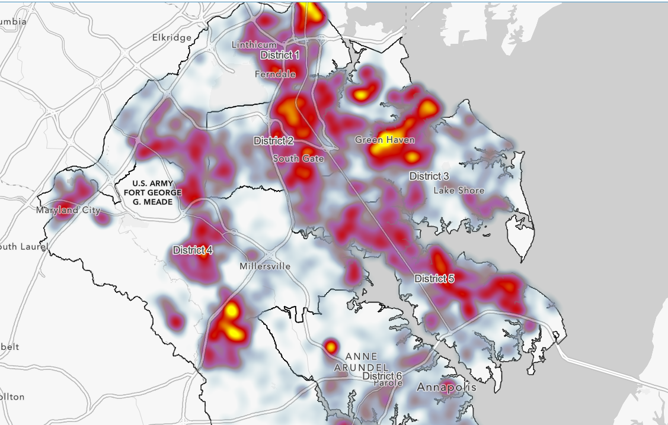
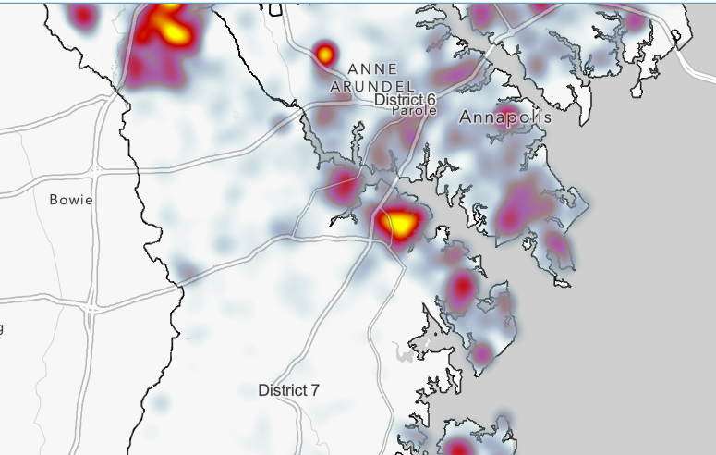
Heatmap Insights - Low Activity Areas
Moderate Activity in Districts 4 and 6
District 4, especially around Millersville, shows some pockets of moderate activity compared to northern districts.
District 6 (near Annapolis) occasionally shows hot spots due to governmental and tourist activity.
Low Activity in District 7
District 7 shows significantly fewer service requests, aligning with its rural nature and lower population density.
Correlation Between Population and Requests
The heatmaps confirm a positive correlation between population density and service requests. Higher population areas (Districts 1, 2, 3, 5) experience more service demands, while less populated areas (District 7) show lower service demand.
Conclusion:
Urban Areas: More populated districts experience higher volumes of service requests due to a combination of population size and heightened service needs.
Rural Areas: In contrast, districts with lower population densities, such as District 7, show fewer service requests, correlating with lower service demand.

Slide 13
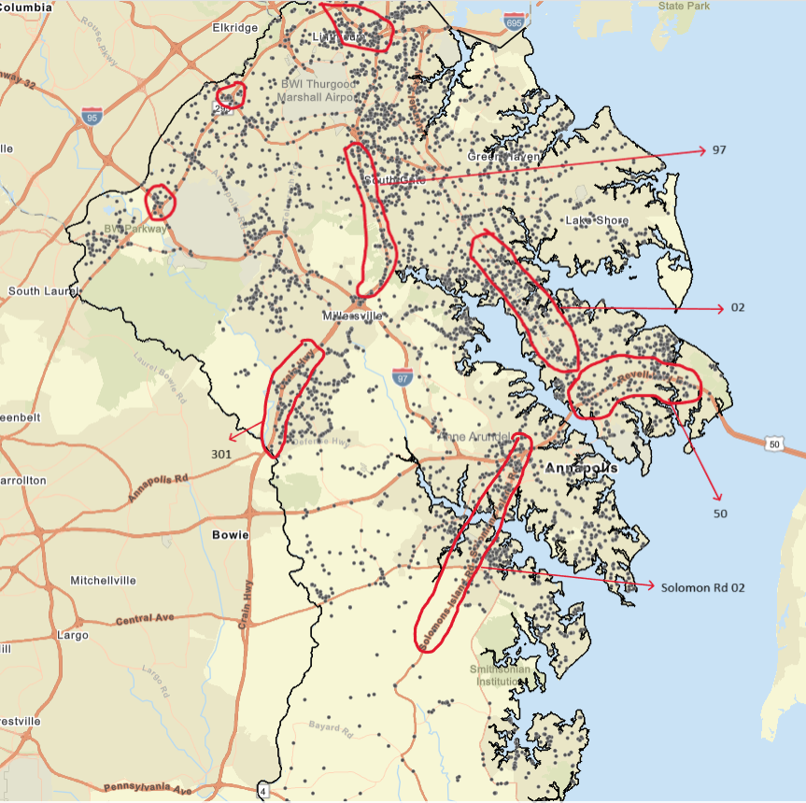
Potholes Analysis
Pothole Density Near Highways
The red-highlighted areas on the map indicate the highest concentration of pothole reports. Major highways such as:
Routes 2,97,301,50
Segments of these routes exhibit higher densities of pothole-related service requests, likely due to the high volume of traffic and significant wear and tear.
Identified Hotspots
Clusters of pothole reports were observed around high-traffic areas like:
BWI Parkway and areas near Route 50.
Linthicum and BWI Thurgood Marshall Airport
These hotspots are along major commuter-heavy and regional connector routes, prone to more frequent pothole formation due to heavy vehicle usage.

Slide 14
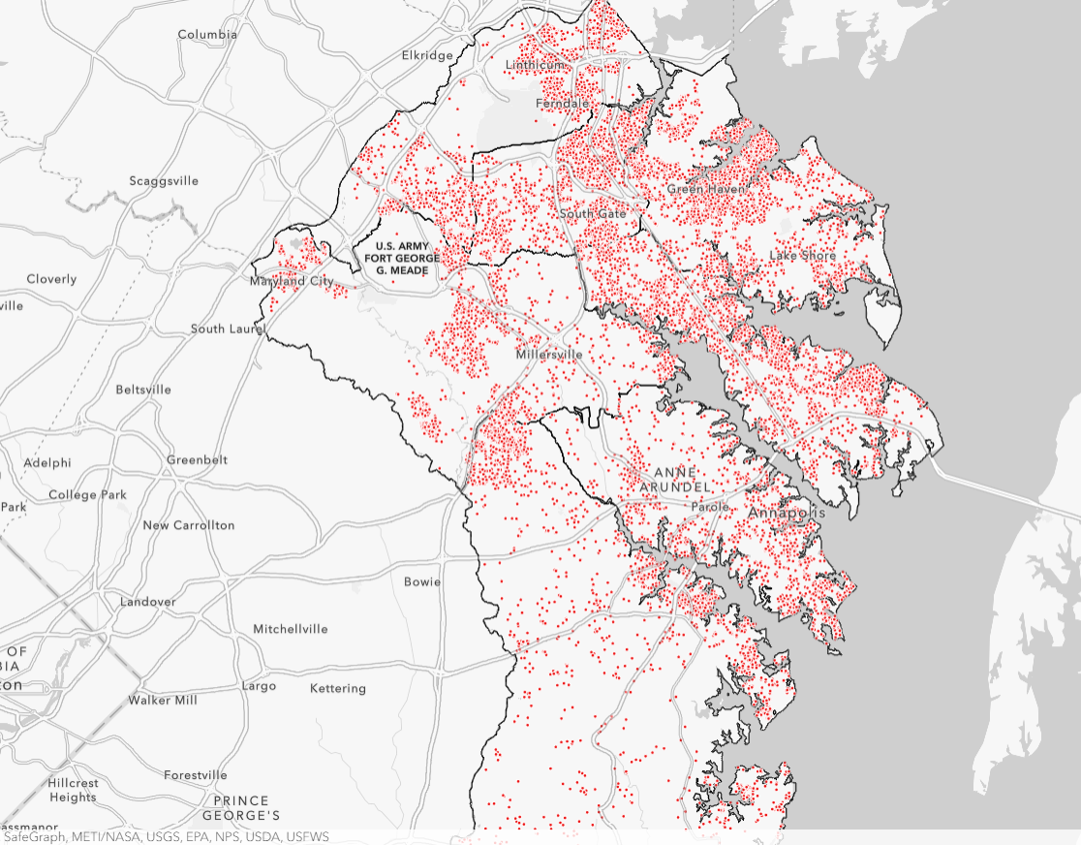
Recycling Request Analysis
High Volume of Requests
The red dots on the map show the widespread distribution of requests for new recycling containers across Anne Arundel County.
This high density suggests that recycling container requests are very common, spanning both urban and rural areas.
Concentrated Areas
Major clusters of requests are seen in: Green Haven, Millersville, Lake Shore, Annapolis
These are high-density residential areas, which likely drive the increased demand for recycling services.
Additionally, Maryland City and areas near the BWI Parkway also show significant clusters, reflecting high service demands in these regions.
Geographic Trends
Recycling container requests are spread across both suburban and rural areas, demonstrating consistent demand across the county.
However, there are fewer requests in the southernmost parts of the county (e.g., near Jessup and Tipton Airport), likely due to lower population density or better recycling infrastructure.

Slide 15
Recommendations to Improve Performance and Focus Areas
Increase Resources for DPW:
75% of requests are to the Department of Public Works (DPW). Allocating more resources to this department is crucial.
Address Delays in P&Z and OIT:
Planning & Zoning (P&Z) and Office of Information Technology (OIT) have long closure times, averaging 175-202 days. These departments need to streamline their processes.
Improve DPW Service Quality:
Although DPW closes requests quickly, it has the lowest average rating (2.4/5). Quality improvement measures are needed.
Prioritize Highways & Recycling Services:
Highways (Route 2, 97, 301) have high pothole reports due to heavy traffic. Prioritize road maintenance in these areas.
Focus on high-demand areas for recycling container requests, especially in densely populated regions.
Optimize Service Request Closure:
Cable TV and Permits subdivisions take over 200 days to close requests. Address these bottlenecks.
Improve closure times for requests reported via Phone and Email, which take over 80 days.

Slide 16

Questions ?

